Slide 1
TESTING THE WATERS: USING COLLECTIVE REAL OPTIONS TO MANAGE THE SOCIAL DILEMMA OF STRATEGIC ALLIANCES
MATTHEW W. MCCARTER
JOSEPH T. MAHONEY
GREGORY B. NORTHCRAFT
Academy of Management Review (2011)
Prepared by Deepika Chhillar, Spring 2021; Revised by Bryn Choi, Spring 2023

Slide 2
Paper Overview
A theory paper with a conceptual model examining how the use of real options can influence the likelihood of alliance success
Two critical factors influencing alliance success: environmental uncertainty and social uncertainty Research Question
How do collective real options impact the management of social uncertainty in strategic alliance social dilemmas?

Slide 3
Key Terms
Strategic Alliance
“Voluntary arrangements [among two or more organizations] involving the exchange, sharing, or co-development of products, technologies, or services” (Gulati, 1998: 293)
Environmental Uncertainty
Stems from lack of information about market & firms’ fear of poor ROI
Social Uncertainty
Stems from lack of information about intentions of alliance partners, leading to mistrust →impedes inter-firm cooperation
Small Wins
“Concrete, complete, implemented outcome[s] of moderate importance” (Weick, 1984: 43)
Represent an opportunity for alliance partners to see (preview) the potential value of successful cooperation.

Slide 4
Social Dilemma Paradigm
Definition: “A situation in which it appears that being uncooperative can be personally beneficial at the collective’s expense— unless everyone else in the collective also chooses to be uncooperative, in which case no one benefits” (Liebrand, 1983).
Offensive defection (free-ride)
Defensive defection (suspicion of others)

Slide 5
Social Dilemma Paradigm - Solutions
Structural Solutions
Motivational Solutions
Manage Social Uncertainty
$$=$$
COSTLY DEFECTION
Sanctions - threatening monetary fines or spread of bad reputation for defecting alliance partners
INCREASING TRUST
Meet frequently to plan, discuss goals & communicate intentions before contributing resources toward alliance initiatives

Slide 6
Solutions’ Limitations
Structural Solutions
Motivational Solutions
Manage Social Uncertainty
≉
Unable to cover every possible free-riding loophole
Goodwill decreases as # of control provisions increase
Reliance on verbal reassurances may be viewed as “cheap talk”

Slide 7
Collective Real Options
Real Option: A right – without an obligation – to invest resources (e.g., labor, money, time) toward a course of action at a future point in time
Collective Real Option
An action undertaken jointly by alliance partners when all partners agree to make a small initial investment of resources to uncover environmental and social information about the possible success of a subsequent larger-scale alliance initiative
Differs from other real options in the coordinated action that provides the opportunity to reduce social uncertainty in the alliance
Bridge structural and motivational approaches to create a hybrid solution to alliance governance

Slide 8
Collective Real Options
“First We Try, then We Trust”
Trust is an individual’s “expectations, assumptions or beliefs about the likelihood that another’s future actions will be beneficial, favourable, or at least not detrimental” to the individual (Robinson, 1996: 576), and it is formed through social interaction
Collective Real Option → Small wins → High Trust and Low vulnerability → Mutual Co-operation in the alliance
Notes:
Collective Options foster mutual co-operation in the alliance via small wins which breed trust among the partner firms in the alliance, and reduce vulnerability. Authors propose a model to illustrate this effect.

Slide 9
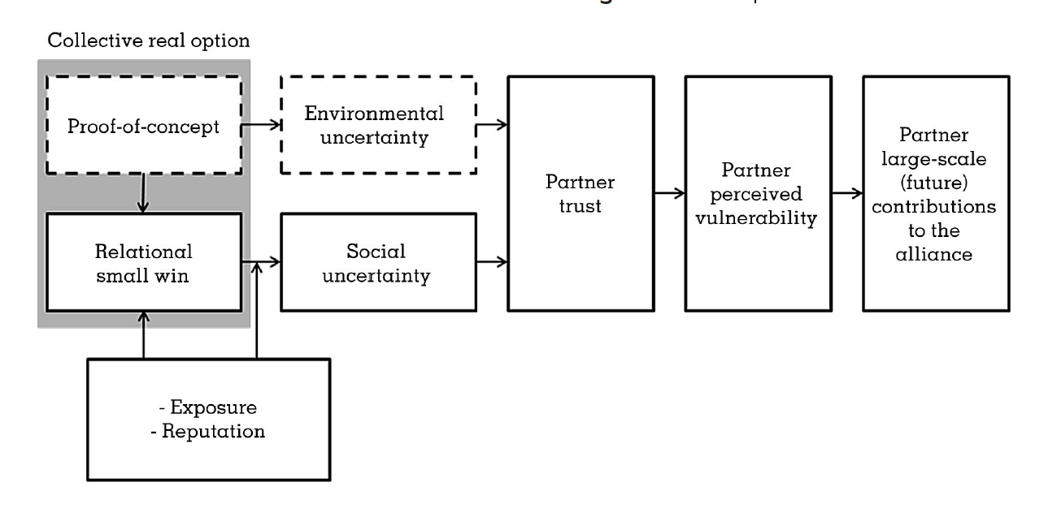
A Conceptual Model of a Collective Real Options Approach to the Social Dilemma of Strategic Alliances
Notes:
The core logic of this model comes in five parts :
1-5
Propositions 1-3 constitute the base model

Slide 10
CORE LOGIC
(1) Large-scale alliance cooperation represents a social dilemma requiring trust.
(2) Collective real options offer alliance partners the opportunity to achieve relational small wins that increase trust.
(3) Increased trust decreases the perceived vulnerability among alliance partners and, thus, fuels larger-scale alliance cooperation.
(4) Exposure (amount of resources put at risk by alliance partners to acquire the collective real option) moderates the effect of a relational small win on trust development.
(5) The reputations of alliance partners also play an important role in the impact of collective real options.
Proposition 5: The positive reputations of other alliance partners increase the likelihood of investment by alliance partners to realize a relational small win of mutual cooperation.
Proposition 6: Achieving relational small wins will have more of an effect on trust among alliance partners when reputations are positive than when there is no reputation information.
Proposition 7: Failure to achieve small wins will have less of an effect on trust among alliance partners when reputations are positive than when there is no reputation information.
Proposition 2a: As trust among alliance partners increases, perceived vulnerability experienced by those alliance partners decreases.
Proposition 2b: Trust mediates the relationship between relational small wins and perceived vulnerability of alliance partners.
Proposition 3: An alliance partner will
be less likely to contribute toward the alliance’s initiatives when perceived vulnerability is higher.
Proposition 4a: As exposure in acquiring the collective real option decreases, the likelihood of investment by alliance partners to realize a relational small win of mutual cooperation increases.
Proposition 4b: Exposure in acquiring the collective real option will moderate the relationship between relational small wins and trust such that relational small wins of mutual cooperation will have a less beneficial effect on trust among alliance partners
when exposure is low than when exposure is high.
Proposition 1: Alliances that experience the relational small wins of mutual cooperation by successfully acquiring collective real options will experience higher trust compared to alliances that do not experience relational small wins of mutual cooperation by successfully acquiring collective real options.
Notes:
The core logic of this model comes in five parts :
1-5
Propositions 1-3 constitute the base model

Slide 11
Contributions And Future Research
Theoretical Implications and Managerial Implications for:
Real Options literature
Alliance governance
Co-operation in alliances
Future Research Directions
Role of alliance size (number of alliance partners)
When collective action entails a large number of partners (often beyond two parties), unilateral strategies, such as direct reciprocal exchange and sanctioning, becomes difficult to implement because of increased monitoring costs and complexity
What effects do collective real options have on external alliance relationships?
Organizational Learning from (not) achieving small wins

Slide 12
Key Take-Aways
Using a collective real options approach enables us to explain and predict how an appropriately sized small win is the first step in completing the long journey toward having alliance partners successfully working together.
Lucid writing style and extraordinarily well-explained paper!

Slide 13
Discussion
As an industry matures, reputation effects grow stronger – would there be barriers to entry for new members to an alliance? What are some strategies that can mitigate this effect?
Relatedly, would there be imprinting effects on incumbent firms that put them at a disadvantage?

